Slide 1
Project Proposal
Course : Operating System
Instructor : Mr. Nadeem Iqbal

Slide 2
Group Members
Muhammad Huzzifa Hafeez (2020-CS-606)
Hafiz Abdul Rehman (2020-CS-624)

Slide 3
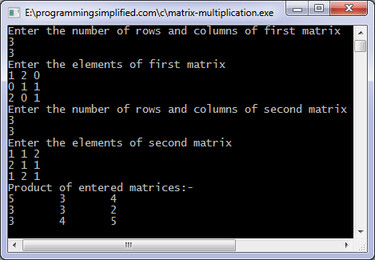
Project Topic
Matrix Operation in C using Threads

Slide 4
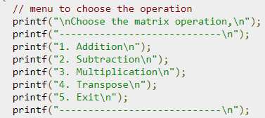
Matrix Operations
Operations Like :
Addition
Subtraction
Multiplication
Transpose of a matrix etc..

Slide 5
Implementation
We use C language in that project for implementing Matrix Operations.
The project shall be menu driven.
On user Choice it will perform Operations like Addition, Subtraction etc.
We also use Multithreads for that implementation in which each thread executes the required Operation.

Slide 6
Some Important Uses of Matrices
Matrices are used in Science of optics to account for reflection and refraction.
A matrix (A) is a rectangular array of numbers, parameters, or variables that can be used to solve problems.
Matrix Cramer's Rule and determinants are useful tools for resolving various problems in business and economics involving profit maximization and loss minimization.

Slide 7


